Slide 1
Final Presentation
Franklin Willemen, Maura van der Linden, Qi Draaisma, Lars Zandbergen & Celena Jordaan
Notes:
Hello everyone, we are Franklin, Maura, Qi, Lars and I am Celena and this is our Final Presentation

Slide 2
Contents
The Challenge
Our vision
The result
Future work
Notes:
During this presentation we are going to talk about the challenge our team got for this project. The vision we had for it, the final result we achieved and some ideas for future work.

Slide 3
Entrepreneurs Challenge
Profitable Website
SEO: Search Engine Optimization
Growing web traffic
Increasing visibility of the website
Adsense
Google
Targeted advertisements
Generate income
Notes:
Our team got the entrepreneurs challenge, which had only one big requirement. Making a profitable website, which meant that the team had to generate revenue from the website. To achieve this the team used two main elements. The first one is SEO, search engine optimization. This helps to increase the quantity and quality of your website traffic. It also increases the visibility of your website on search engines like Google. The second element we used was Adsense. Adsense is run by google and makes it possible to get advertisements on your website that are targeted to the site content and audience. These advertisements help us to generate the income, and the SEO helps to get more visitors, which will eventually mean more income.

Slide 4

Our Vision
What: Artificial Intelligence project platform
Who: AI Start-ups and students.
Why: For students, by students

Slide 5

The Result

Slide 6
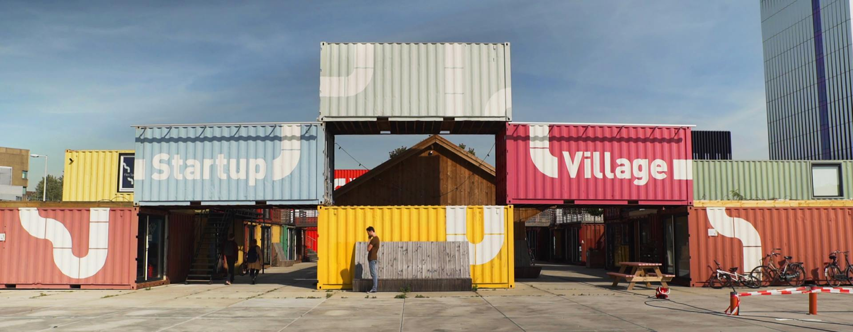
Startups
Startup Village Amsterdam
Response from Sercxi

Slide 7
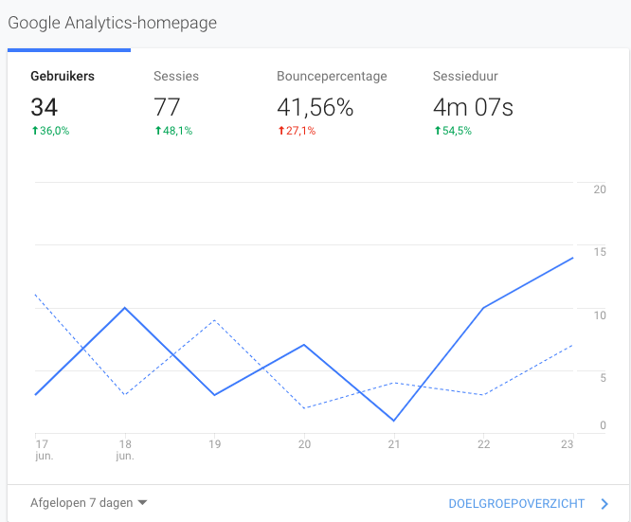
Google Analytics: Users

Slide 8
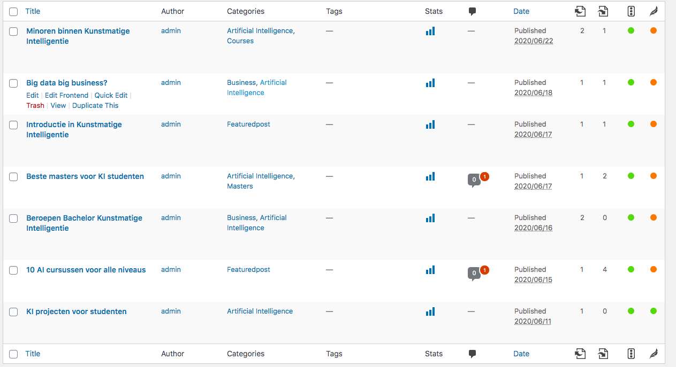
SEO: score & readability
Notes:
score & readability

Slide 9
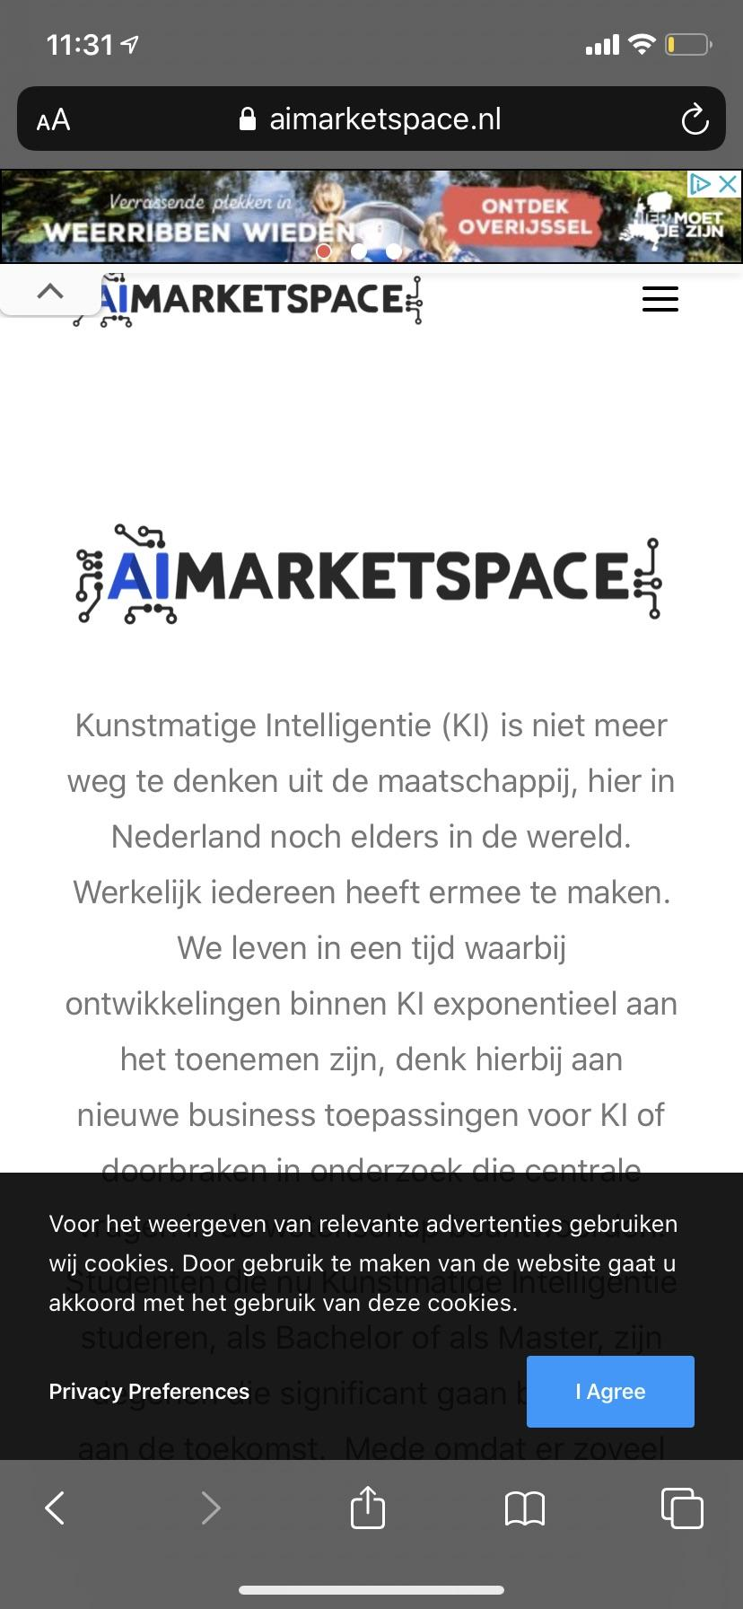
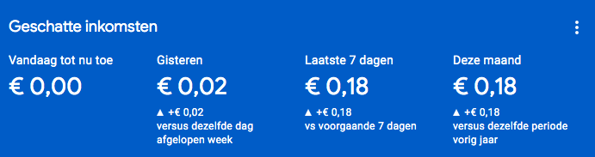
Adsense

Slide 10
Future Work
Artificial Intelligence
Voice search
Content creation
Matching
Chat bot
Service development
Skill challenges
Broadening scope
Accounts
Business
Established names
Universities and labs
Join AI networks
Notes:
Voice search enhances UX
AI content generation would help with SEO
Matching student and companies for the perfect fit.
Chat bot instead of contact forms etc
Skills challenges would be of great value for both start-ups and students. Getting insight into the real technical skills.
Broading scope: including research work.
Students and companies can create accounts.
Established names: Include corporates, Universities and labs in outreach efforts.
Join various AI networks.

Slide 11
Any Questions?

